Slide 1
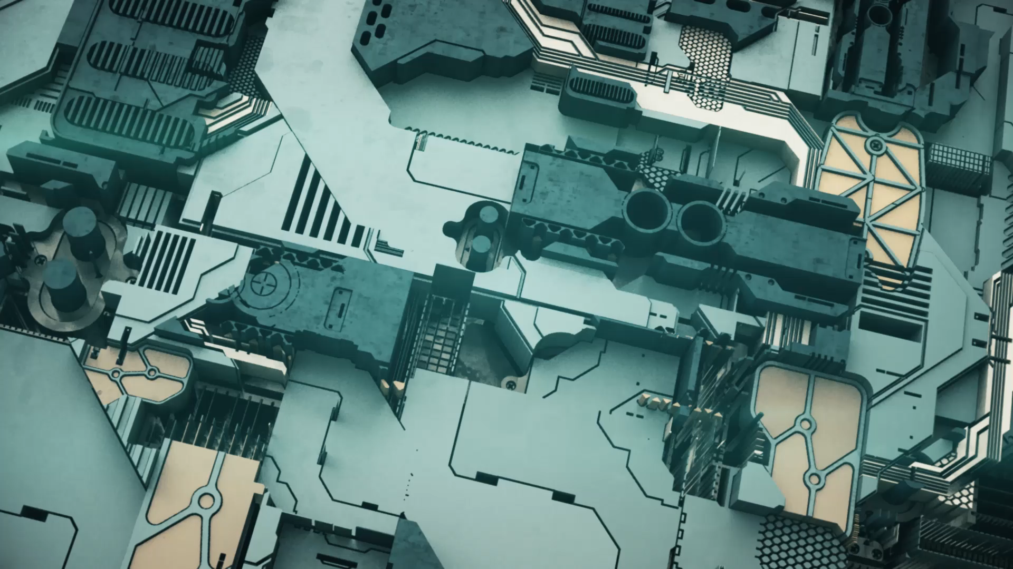
Transformers Illustration
Nano Computing Research Group
By
Srinivas Rahul Sapireddy

Slide 2

Contents
Introduction
Self-Head Attention
Multi-Head Attention

Slide 3
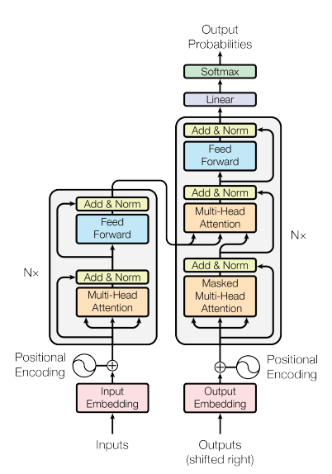
High Level Overview of Transformers
Originally designed for Natural Language Processing.
Here we are working with encoder and decoder architecture.
Output of last encoder layer is sent to decoder layer.
Both the encoder and encode has N layers.
After N amounts of layer’s, we are going to use linear projections over the hidden representations and a softmax which will output a word.
Output of one word is used to create the next time step of the decoder.

Slide 4
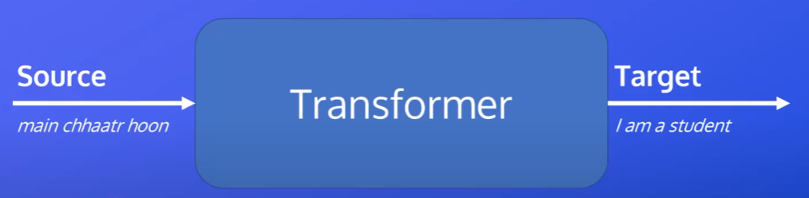

Feed in inputs to transformers and we decode the words into outputs.

Slide 5
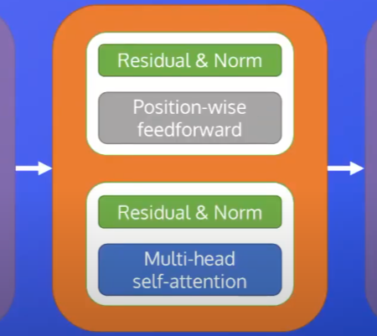
Sublayers of Encoders
Output of one encoder layer will be input to next encoder layer.
Encoder sublayers
[1] Multi-head self attention (core of how transformers work)
Residual and Norm
[2] Position-wise FFN
Residual and Norm

Slide 6
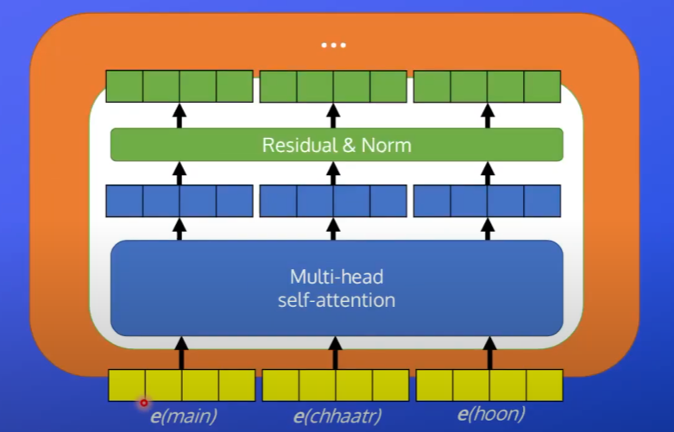
Architecture of Single Encoder Layer
We have 4 dimensions representing each of our words.
In this case we have 3 words.
In transformers dimensionality is fixed in every layer of the model.
Outputs of Self-Attention will be taken into the form of representations which are hidden
Dimension of each word after attention = 4
W1
W1
W1
Dimension of each word = 4

Slide 7
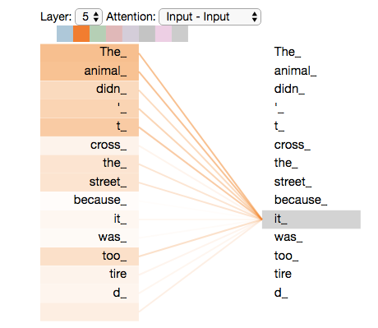
Self-Attention
Every word looks at every other word then it bases its representation of that one word based on the other words inside of the sequence.
The animal didn’t cross the street because it was too tired
- What does it refer to?
Does it refer to animal or street.
We use self-attention to encode one word based on every
other word to encode its meaning.
How?
It pays more attention to The Animal

Slide 8
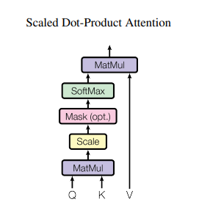
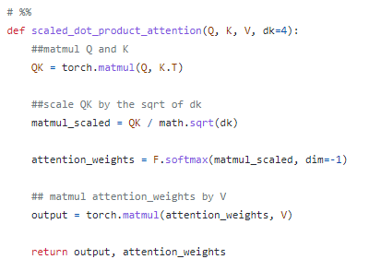
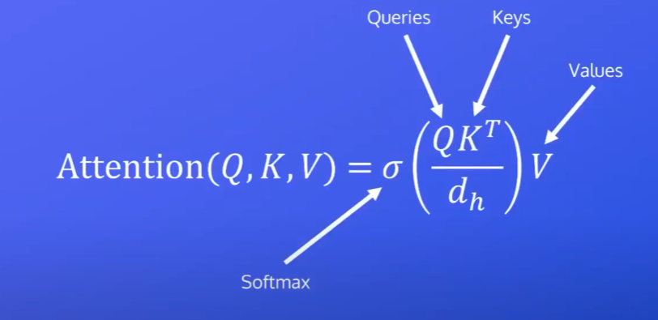
How?
Softmax gives us a probability distribution where everything sums up to 1.
Attention will give final representations for every word in input sequence.
Dimensionality of the model

Slide 9
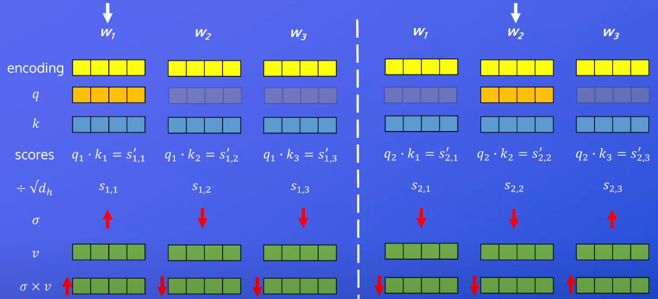
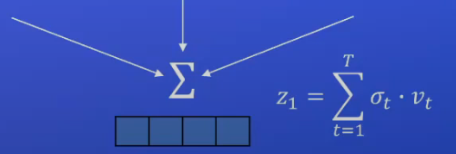
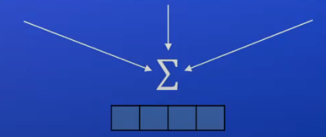
Scaled Dot Product
For every K vector we want to find vectors where Q is similar.
Most of the information is coming from here
0.6
0.2
0.2
Vector representation for word 1
Vector representation for word 2

Slide 10
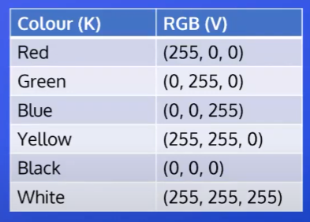
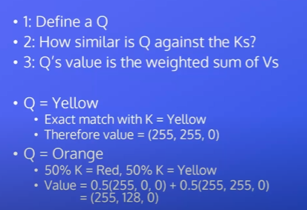
Intuition
Here value of query is based on the other values.

Slide 11
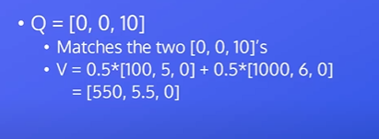
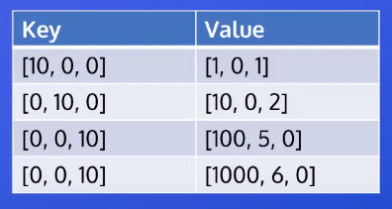

Slide 12
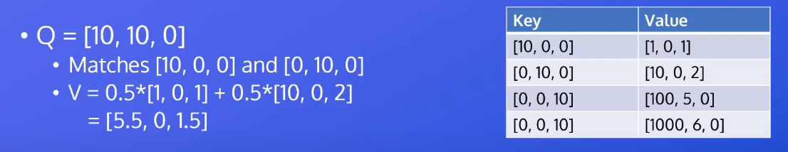
We will learn representations for every query, key and value for every single word.

Slide 13
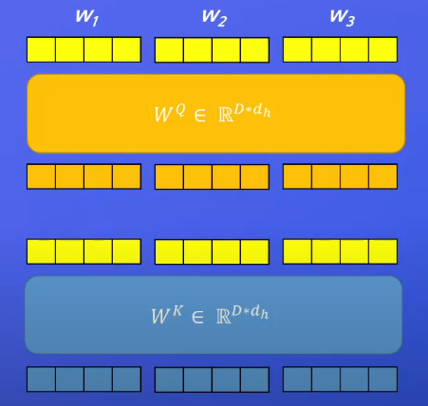
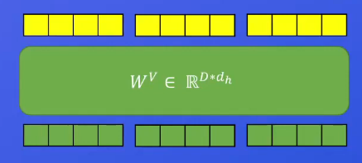
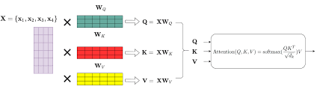
Self-Attention
We will have linear layers learn the representations of Q, K, V for every single word.
Representations are learnt by the linear layer network
Different representations of the network
Positional Encodings

Slide 14
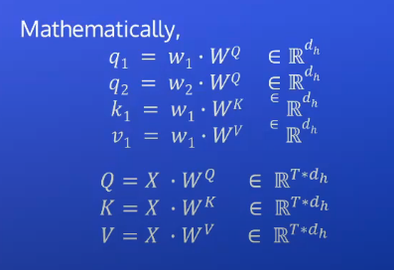
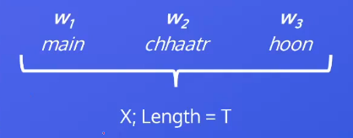
Mathematically
Notes:
Same encodings are fed into Q, K, V network.
Because of different sets of weight’s, we are going to learn different representations.
For every single word we have Q, K, V representations
Weights of linear network
Word 1
Q value of word 1
Length of our sequence (3 in our case) – dimension of the model
v1 for word 1 v2 for word 2 v3 for word 3
Dimension of our word in the sequence
word 1
word 2
word 3

Slide 15
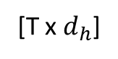
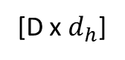
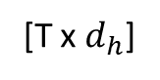
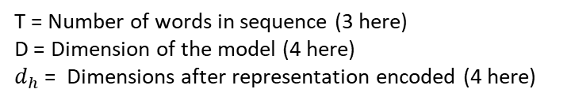
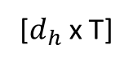
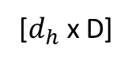
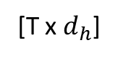
Dimensions of Attention
[T x $d_{h}$]
[$d_{h}$x T]
[T x $d_{h}$]
[T x D]
[D x $d_{h}$]
[$d_{h}$x D]
[T x $d_{h}$]
T = Number of words in sequence (3 here)
D = Dimension of the model (4 here)
$d_{h}$= Dimensions after representation encoded (4 here)
Weighted representations of every single word
[T x T]

Slide 16
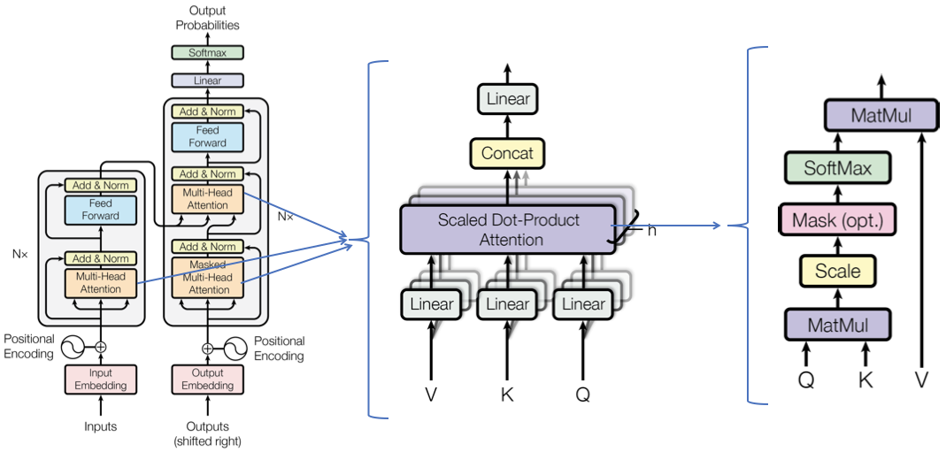
Multi-Head Self-Attention
Same thing as self-attention but performs self-attention head amounts of times.
If we have 3 heads it performs self-attention 3 times.
The original transformer used 8 heads.
So, we run self-attention 8 times over 8 K’s, V’s and Q’s.
Final representation comes from concatenation of individual self-attention outputs.
Each head has dimensionality = D/Heads.
- D here is the model dimensionality.
How may number of heads we have we are going to initialize that many number of linear layers.
In our case we have 2 heads, so we are going to initialize 2 linear layers

Slide 17
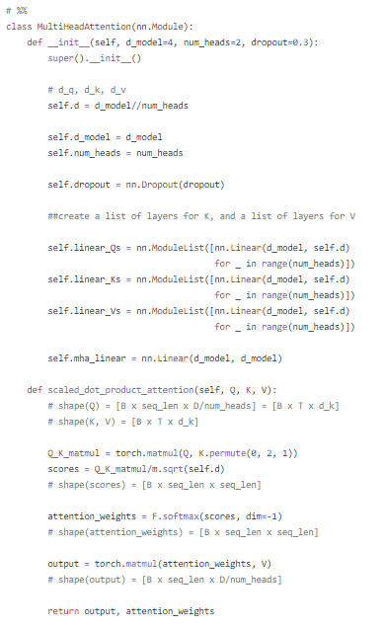
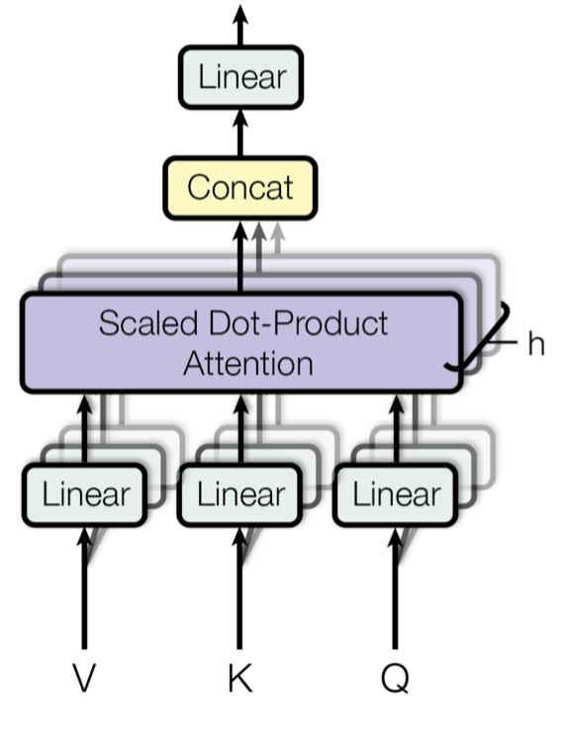
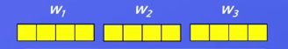
d_model = 4
Dimension of each word
Number of heads = 2
So, we have 2K’s, 2Q’s, 2V’s
Linear Layers initialization
Example:
Number of words in sequence = 3
Dimension of each word = 4
Number of heads = 2
Number of batches = 1
[1 x 3 x 2]
[1 x 3 x 2]
*
[1 x 3 x 3]
[1 x 3 x 2]
[1 x 2 x 3]
[1 x 3 x 3]
Input Dimension = Output Dimension
[1 x 3 x 4/2]

Slide 18
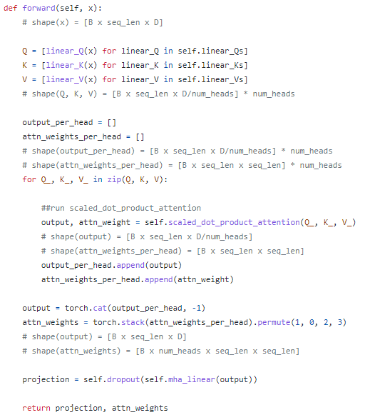
[1 x 3 x 4]
[1 x 3 x 4/2] * 2
[1 x 3 x 4/2] * 2
We have equal dimensions for input and outputs
[1 x 3 x 4/2] * 2
[1 x 3 x 4/2]
[1 x 3 x 3]
[1 x 3 x 4]
[1 x 2 x 3 x 3]

